Slide 1

Shape of the distribution
Santosh chhatkuli

Slide 2
Skewness
The graphical features of a distribution are most commonly described in terms of skewness and kurtosis. The frequency curve representing the observed frequency distribution may be either symmetrical or skewed or irregular shapes. An asymmetrical distribution is called skewed distribution. Skewness means lack of symmetry.
Types of Skewness:
Zero skewness (Symmetrical or Normal distribution)
Right Skewness or Positive Skewness
Left Skewness or Negative Skewness

Slide 3
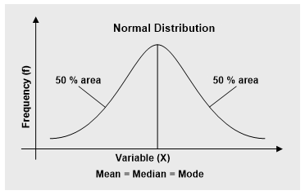
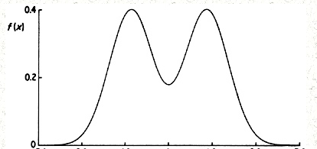
Symmetrical or Zero Skewed distribution
A distribution is said to be symmetrical or zero skewed if a vertical line drawn from the center of the frequency curve of distribution to the axis divides the area of the curve into two equal parts such that each part is mirror image of the other.
For symmetrical distribution, Mean = Median = Mode
The distribution in the right is symmetrical but not normal. All symmetrical distributions are not normal.

Slide 4
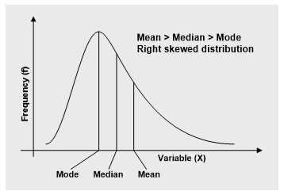
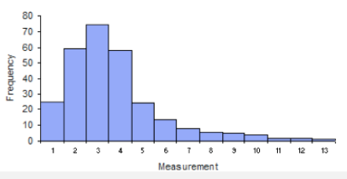
Positive Skewness
If more observations lie to the left of the mean, the distribution is balanced at the mean by a long tail to the right then the distribution is said to be positively skewed or right skewed. Right tail is heavier than the left tail. The positive skewness arises when mean is increased by some unusually high value. These extremely high values pull the mean upward and frequency curve is distorted to the right.
Example: Wealth of people in the country, Marks of students in difficult exam, Salary of employee of a company, No. of children in family etc

Slide 5
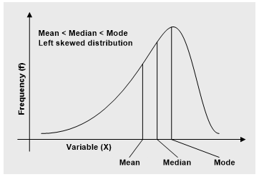
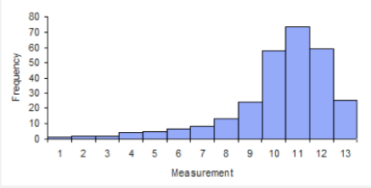
Negative skewness
If more observations lie to the right of the mean, the larger tail extends to the left then the distribution is said to be negatively skewed or left skewed. The left tail is heavier than right tail. Negative skewness occurs when mean is reduced by some extremely low values. These extremely small values pull the mean downward and the frequency curve is distorted to the left.
Example: Marks of students in easier exam, Household income of rich country, age at death etc.

Slide 6
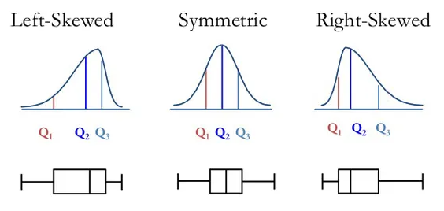

Slide 7
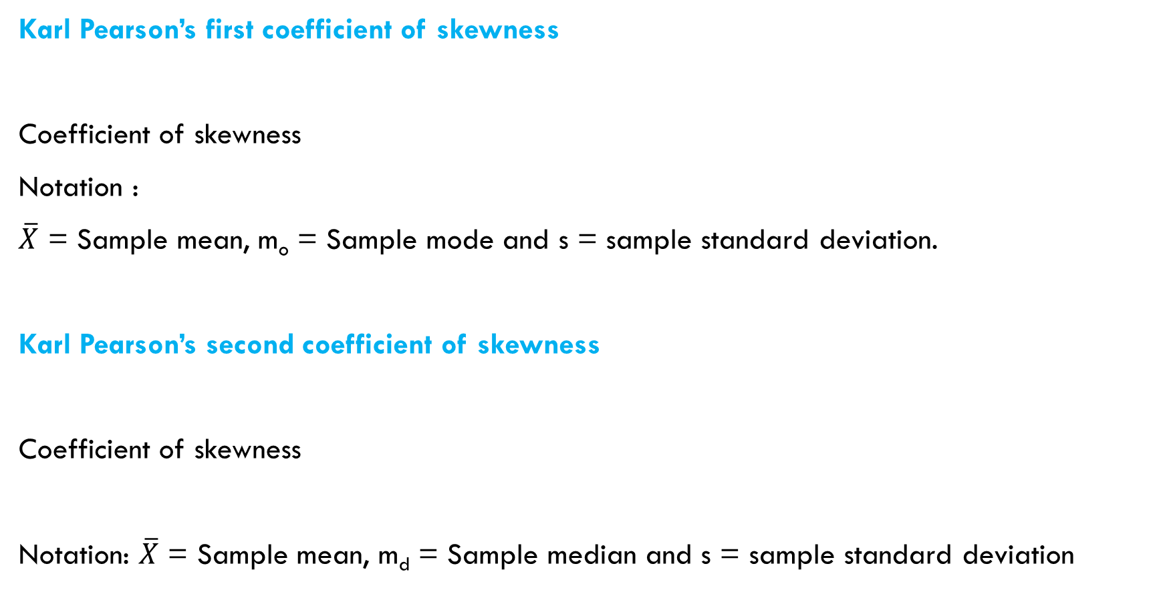

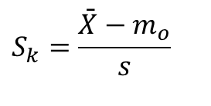
Measures of skewness
Karl Pearson’s first coefficient of skewness
Coefficient of skewness
Notation :
$\overline{X}$ = Sample mean, m_{o} = Sample mode and s = sample standard deviation.
Karl Pearson’s second coefficient of skewness
Coefficient of skewness
Notation: $\overline{X}$ = Sample mean, m_{d} = Sample median and s = sample standard deviation
$$S_{k}=\frac{\bar{X}−m_{o}}{s}$$
$$S_{k}=\frac{3 (\bar{X}−m_{d})}{s}$$

Slide 8
The value of S_{k} in the second equation lies between
-3 and +3.
Interpretation:
If S_{k} = 0, then distribution is symmetrical. Any symmetrical distribution should have a coefficient of skewness near zero.
if S_{k} > 0, then distribution is right skewed and
if S_{k} < 0, then distribution is left skewed.

Slide 9
Example: The following are the ages of 48 patients admitted to the emergency room of a hospital. Compute coefficient of skewness . How would you describe the shape of these data?
32 63 33 57 35 54 38 53 42 51 42 48 43 46 61 53 09 13 16 16 31 30 28 28 25 23 23 22 21 17 13 30 14 29 16 28 17 27 21 24 22 23 61 55 34 42 13 26
Solution:
Conclusion: The distribution of age of patients is right skewed

Slide 10


Measure of skewness based on partitioning values
Bowley’s coefficient of skewness
Coefficient of skewness =
The Bowley’s coefficient of skewness ranges from -1 to +1 i.e. -1 ≤ S_{k}(B) ≤ +1.
Kelly’s coefficient of skewness
Coefficient of skewness =
The Kelly’s coefficient of skewness also ranges from -1 ≤ S_{k}(K) ≤ +1.
Interpretation:
In both formula S_{k} = 0 implies absence of skewness or symmetrical distribution. The value of S_{k} greater than 0 indicates positive skewness and value of S_{k} lesser than 0 indicates negative skewness.
$$\frac{(Q_{3}−Q_{2})−(Q_{2}−Q_{1})}{Q_{3}−Q_{1}}=\frac{Q_{3}−2Q_{2}+Q_{1}}{Q_{3}−Q_{1}}$$
$$\frac{(P_{90}−P_{50})−(P_{50}−P_{10})}{P_{90}−P_{10}}=\frac{P_{90}−2P_{50}+P_{10}}{P_{90}−P_{10}}$$

Slide 11
Kurtosis
Kurtosis refers to ‘flatness’ or ‘peakedness’ of a frequency curve in comparison to normal curve. It is the fourth characteristic of a set of observations which shows degree of departure form normal distribution and it related to the size of the curve not its shape. Data sets with high kurtosis tend to have a distinct peak near the mean, decline rather rapidly, and have heavy tails. Data sets with low kurtosis tend to have a flat top near the mean rather than a sharp peak. Kurtosis is a measure of how outlier-prone a distribution is.
Types of Kurtosis
1. Mesokurtic Distribution (Zero kurtosis or Normal distribution)
2. Leptokurtic Distribution (High Kurtosis)
3. Platykurtic Distribution (Low Kurtosis)

Slide 12
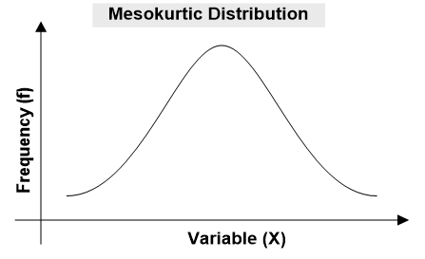
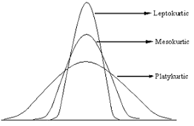
Mesokurtic Distribution
The distribution which is not very peaked or very flat-topped is called Mesokurtic. In this distribution more observations lie in the ‘shoulders’ and around mean. Distribution is bell shaped and is called normal distribution.

Slide 13
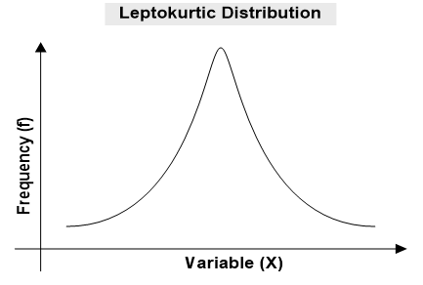
Leptokurtic Distribution (Positive kurtosis)
“Lepto” means “slender”. A distribution is said to be Leptokurtic if most of observations are concentrated near the mean and in the tails. The distribution has relatively higher peak than normal curve and has larger tails on both sides. Such a distribution might be the composite of two normal populations with the same variance but different means.
(Sharp peak and more heavier tail than normal distribution)

Slide 14
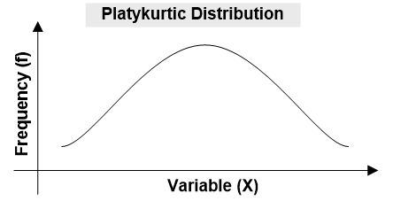
Platykurtic distribution (Negative kurtosis)
A distribution is said to be Platykurtic if large number of observations have low frequency and spread in the mid of class-interval. Frequency curve of Platykurtic distribution is more flat-topped than normal curve. Inter-quartile range is high. Such a distribution might be the composite of two normal populations with the same mean but with different standard deviations. A uniform distribution would be the extreme case.
(Flat peak, more dispersed observations and more thinner or lighter tail than normal distribution)

Slide 15
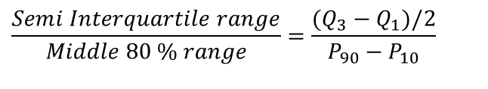
Measures of kurtosis
The kurtosis is measured with the help of Quartiles and Percentiles. Measure of kurtosis based on Quartiles and Percentiles is known as percentile coefficient of kurtosis, and is given by,
Coefficient of Kurtosis (k) =
Notations:
Q₁ = First Quartile, Q₃ = Third Quartile, P₁₀ = Tenth Percentile, P₉₀ = Ninetieth Percentile.
Interpretation:
1. If k = 0.263, the distribution is Normal
2. If k > 0.263, the distribution is Leptokurtic
3. if k < 0.263, the distribution is Platykurtic
$$\frac{Semi Interquartile range}{Middle 80 \% range}=\frac{(Q_{3}−Q_{1})/2}{P_{90}−P_{10}}$$

Slide 16
Measures of skewness and kurtosis based on moments
Moments: Moments in mathematical statistics involve a basic calculation. These calculations can be used to find a probability distribution's mean, variance, and skewness. The term moment has been taken from physics. In physics, the moment of a system of point masses is calculated with a formula identical to that above, and this formula is used in finding the center of mass of the points. In statistics, the values are no longer masses, but as we will see, moments in statistics still measure something relative to the center of the values.​
Types of moments
1. Central Moments
2. Raw Moments

Slide 17
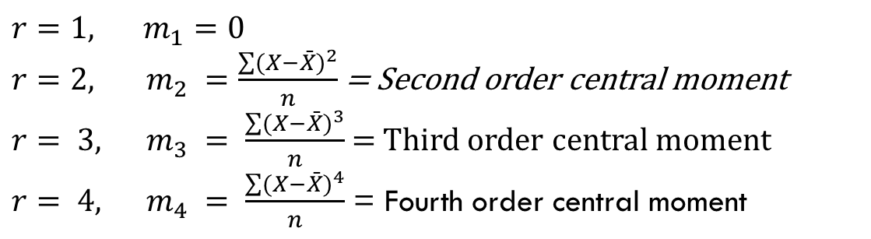


Central Moment
The r^{th} moment about mean (central moment) is defined as:
For frequency distribution the formula is
If,
$$m_{r}=\frac{\sum{(X−\bar{X})^{r}}}{n}$$
$$m_{r}=\frac{\sum{f(X−\bar{X})^{r}}}{n}$$
$$r=1, m_{1}=0$$ $r=2, { m}_{2} =\frac{\sum{(X−\bar{X})^{2}}}{n}$ = Second order central moment $r= 3, m_{3} = \frac{\sum{(X−\bar{X})^{3}}}{n}$= Third order central moment $r= 4, m_{4} = \frac{\sum{(X−\bar{X})^{4}}}{n}$ = Fourth order central moment

Slide 18

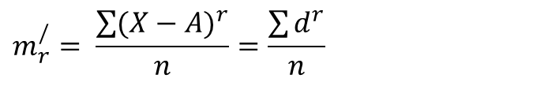

Raw Moment
The r^{th} moment about any arbitrary value A (raw moment) is defined as:
where d = X – A is the deviation of data from any arbitrary value A.
At A = 0, then
For frequency distribution,
$$m_{r}^{/}= \frac{\sum{(X−A)^{r}}}{n}=\frac{\sum{d^{r}}}{n}$$
$$m_{r}^{/}=\frac{\sum{X^{r}}}{n}={\bar{X}}^{r}$$
$$m_{r}^{/}=\frac{\sum{f X^{r}}}{n}$$

Slide 19
Conversion of raw moment into central moment
The raw moment can be converted into central moment by using following formula:

Slide 20




Karl Pearson’s Coefficient of skewness
b₁ is either +ve or –ve , can’t be zero
Fisher coefficient of skewness
Interpretation:
If g₁ = 0, zero skewed distribution
If g₁ > 0, +vely skewed distribution
If g₁ < 0, -vely skewed distribution
Karl Pearson’s coefficient of kurtosis
A b₂ not significantly different from 3 indicates that the sample was obtained from a Mesokurtic population, a b₂ significantly less than 3 indicates the sampled population is Platykurtic, and a b₂ significantly greater than 3 indicates the sampled population is Leptokurtic.
Fisher coefficient of kurtosis
Interpretations:
If g₂ = 0, zero kurtosis or Normal dist.
If g₂ > 0, Leptokurtic distribution
If g₂ < 0, Platykurtic distribution
$$b_{1}=\frac{m_{3}^{2}}{m_{2}^{3}}$$
$$b_{2}=\frac{m_{4}}{m_{2}^{2}}$$
$$g_{1}=\sqrt{b_{1}}=\frac{m_{3}}{m_{2}^{\frac{3}{2}}}=\frac{m_{3}}{m_{2}^{1.5}}$$
$$g_{2} = b_{2} – 3$$

Slide 21
Problems:
1. The grades of student in STATISTICS in final examination is summarized in the following table.
Compute coefficient of skewness and coefficient of kurtosis using central moment
Comment on the shape and size of the distribution
2. A factory produces two types of LED bulbs, A and B. In an experiment relating to their life, the following results were obtained.
(a) Compute first four raw moments taking arbitrary point A = 0
(b) Convert first four raw moments into central moments
(c) Compute coefficient of skewness and kurtosis based on central moment and comment on the shape and size of the distribution
Grades | 52-58 | 58-64 | 64-70 | 70-76 | 76-82 | 82-88 | 88-94 | 94-100 | Total
No. of students | 2 | 12 | 13 | 18 | 14 | 9 | 7 | 5 | 80
Length of life (x 1000hours) | No. of bulbs
 | A | B
0-1 | 4 | 5
1-2 | 11 | 9
2-3 | 25 | 30
3-4 | 12 | 12
4-5 | 8 | 4

Slide 22
Stem and leaf display
Stem-and-leaf display is a graphical method of displaying numerical data and is one of the most useful techniques of exploratory data analysis. It gives the rank order of the numerical observations in the data set as well as the shape of the distribution. It is not suitable for large data set and for continuous random variable.
Stem = The greatest common place value of the data or leading digits
Leaf = The next greatest common place value or trailing digits

Slide 23
Example: The following are the ages of 48 patients admitted to the emergency room of a hospital. Draw a stem-and-leaf display and comment on the size of the distribution.
32 63 33 57 35 54 38 53 42 51 42 48 43 46 61 53 09 13 16 16 31 30 28 28 25 23 23 22 21 17 13 30 14 29 16 28 17 27 21 24 22 23 61 55 34 42 13 26
Example: The following data represent the length of life in years, measured to the nearest tenth of 30 similar fuel pumps.
2.0 3.0 0.3 3.3 1.3 0.4 0.2 6.0 5.5 6.5
0.2 2.3 1.5 4.0 5.9 1.8 4.7 0.7 4.5 0.3
1.5 0.5 2.5 5.0 1.0 6.0 5.6 6.0 1.2 0.2
Draw a stem-and-leaf display and comment on the size of the distribution.

Slide 24
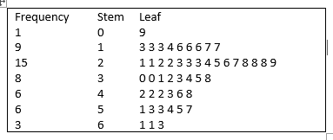
Stem and Leaf display of Age Data
Ordered Array
9 13 13 13 14 16
16 16 17 17 21 21
22 22 23 23 23 24
25 26 27 28 28 28
29 30 30 31 32 33
34 35 38 42 42 42
43 46 48 51 53 53
54 55 57 61 61 63

Slide 25
Stem and Leaf display of fuel pump life data
Data Array
0.2 0.2 0.2 0.3 0.3 0.4
0.5 0.7 1.0 1.2 1.3 1.5
1.5 1.8 2.0 2.3 2.5 3.0
3.3 4.0 4.5 4.7 5.0 5.5
5.6 5.9 6.0 6.0 6.0 6.5
Frequency Stem Leaf
8 0 2 2 2 3 3 4 5 7
6 1 0 2 3 5 5 8
3 2 0 3 5
2 3 0 3
3 4 0 5 7
4 5 0 5 6 9
4 6 0 0 0 5
Conclusion: The shape of the distribution is irregular. There seems to be mix of two distribution. There is trend of two cluster; either low life or higher life

